Slide 1
PIZZA SALES SQL PROJECT
Project Overview: This project delves into the pizza sales data of a renowned pizza company, leveraging SQL queries to extract meaningful insights.
Purpose: Through rigorous analysis, the project aims to uncover key trends, patterns, and opportunities within the pizza business domain.
Approach: Driven by determination and dedication, the project meticulously examines various facets of the data, utilizing SQL as the primary tool for analysis.
Benefits: By efficiently managing time and resources, this project not only enhances understanding of SQL concepts but also provides actionable insights to optimize business strategies.

Slide 2
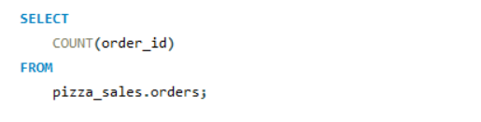
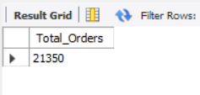
Retrieve the total number of orders placed.

Slide 3
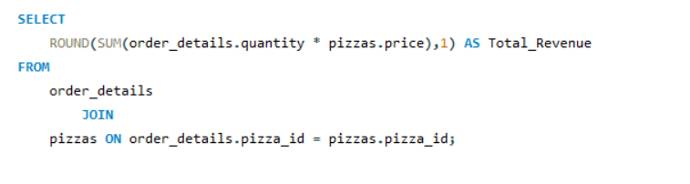
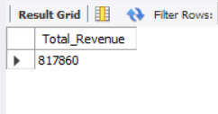
Calculate the total revenue generated from pizza sales.

Slide 4
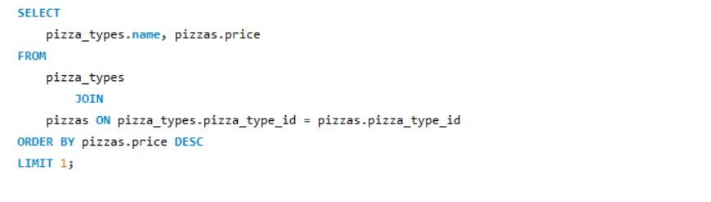
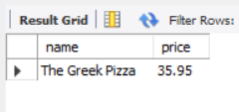
Identify the highest-priced pizza.

Slide 5
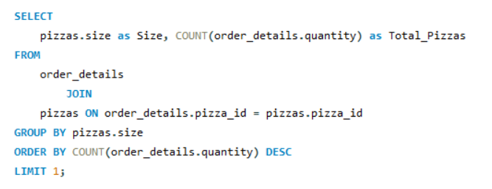
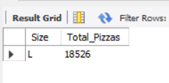
Identify the most common pizza size ordered.

Slide 6
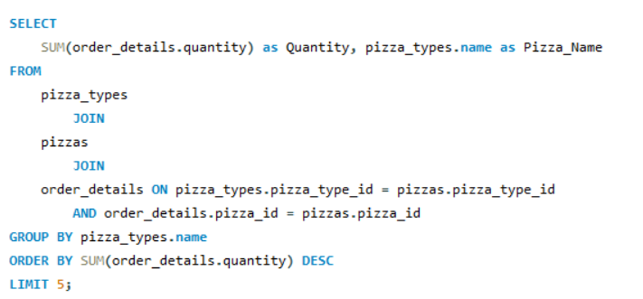
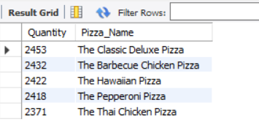
List the top 5 most ordered pizza types along with their quantities.

Slide 7
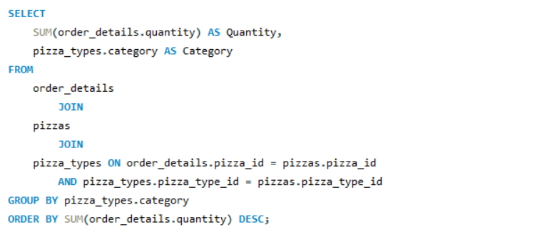
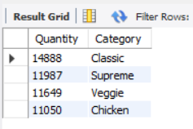
Join the necessary tables to find the total quantity of each pizza category ordered.

Slide 8
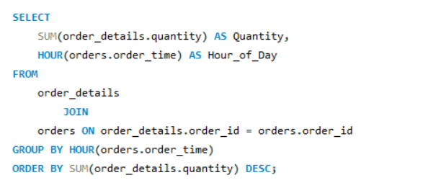
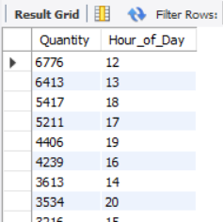
Determine the distribution of orders by hour of the day.

Slide 9
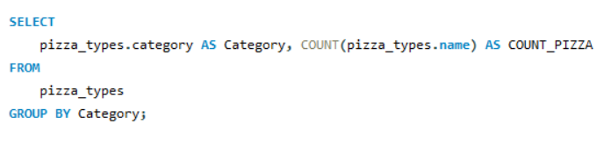
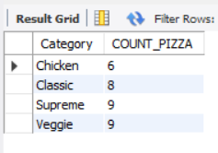
Join relevant tables to find the category-wise distribution of pizzas.

Slide 10
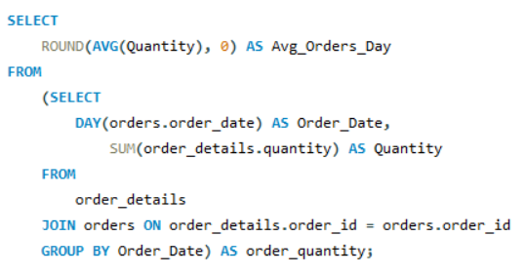
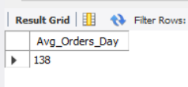
Group the orders by date and calculate the average number of pizzas ordered per day.

Slide 11
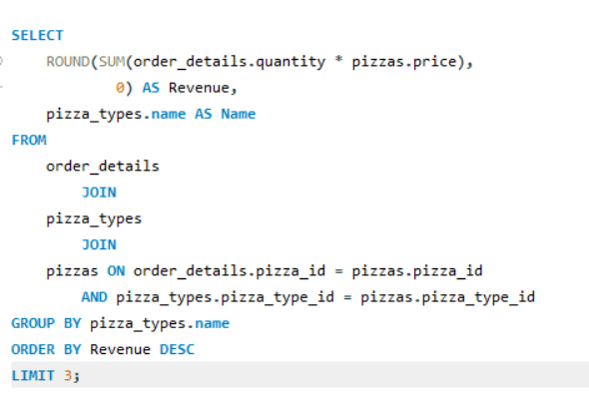
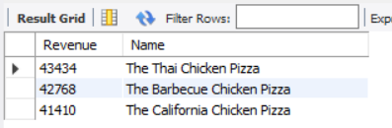
Determine the top 3 most ordered pizza types based on revenue.

Slide 12
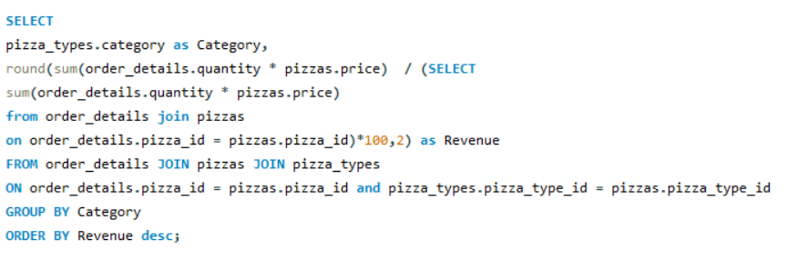
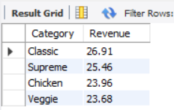
Calculate the percentage contribution of each pizza type to total revenue.

Slide 13
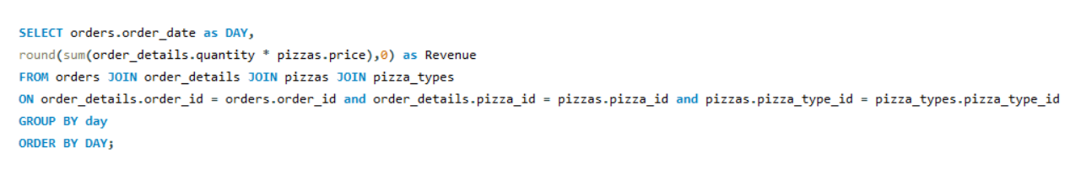
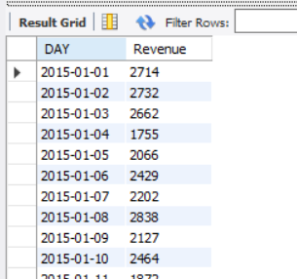
Analyze the revenue generated over time.

